Slide 1


AccuprimeFlow for admins
Verifying discovery calls, paying commissions and running the team.
For: Admins and the super admin
www.accuprimeflow.com
Notes:
AccuprimeFlow for admins. Verifying discovery calls, paying commissions and running the team.

Slide 2

Verification is your job
Only admins record whether a discovery call happened. Commissions depend on it.
1
2
3
4
5
6
Import
Assign
Call
Book
Verify
Pay
Marketing uploads a lead list. Duplicates are caught first.
Leads go to a caller, or are split across the team.
Callers work the queue and log every call with a note.
The caller books a discovery call in the prospect’s time zone.
An admin records what happened after the call. Only admins verify.
Attended calls make commissions payable. Admins pay them.
Only admins verify discovery calls. Callers and marketing never mark a call attended; commissions become payable only after an admin does.
Notes:
Callers book discovery calls, but nobody gets paid until an admin verifies that the prospect attended. Verify every call soon after its time has passed; a nightly email lists anything still waiting.

Slide 3
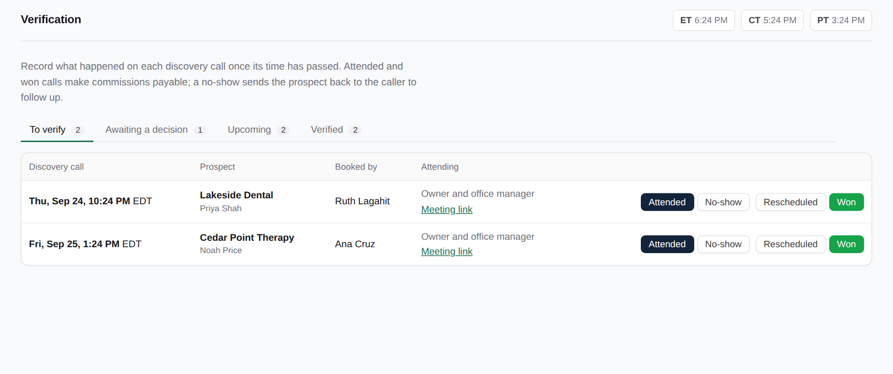
The Verification screen
1
Calls whose time has passed wait in "To verify".
The menu badge shows how many are waiting.
Calls waiting a day or more are flagged.
Other tabs: Awaiting a decision, Upcoming, Verified.
A reminder email goes to admins at 9 PM Eastern while any are waiting.
Notes:
The Verification screen. Calls whose time has passed wait in "To verify". The menu badge shows how many are waiting. Calls waiting a day or more are flagged. Other tabs: Awaiting a decision, Upcoming, Verified. A reminder email goes to admins at 9 PM Eastern while any are waiting.

Slide 4
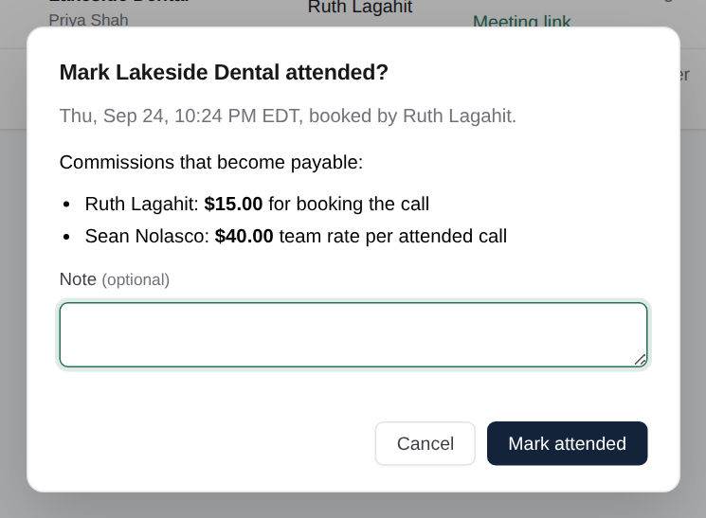
Attended
2
The prospect joined the call.
The confirmation lists exactly who gets paid and how much.
Those commissions become payable immediately.
The prospect moves to "Attended", waiting for a decision.
Notes:
Attended. The prospect joined the call. The confirmation lists exactly who gets paid and how much. Those commissions become payable immediately. The prospect moves to "Attended", waiting for a decision.

Slide 5
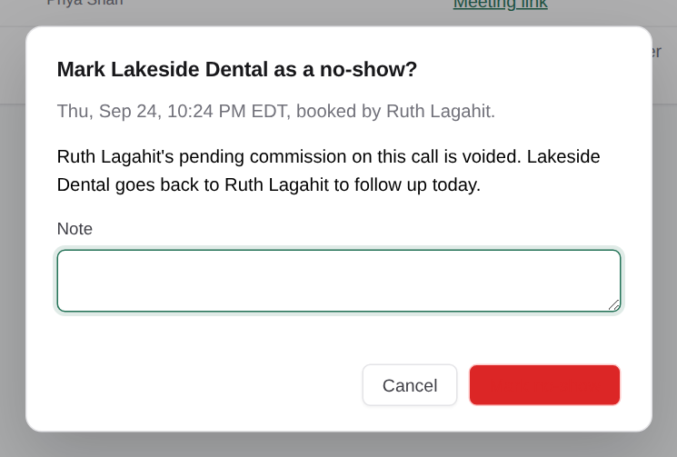
No-show
3
The prospect didn’t join.
Waiting commissions for this call are cancelled. Nobody is paid.
The lead goes back to the caller to follow up today.
Add a note if it helps the caller.
Notes:
No-show. The prospect didn’t join. Waiting commissions for this call are cancelled. Nobody is paid. The lead goes back to the caller to follow up today. Add a note if it helps the caller.

Slide 6
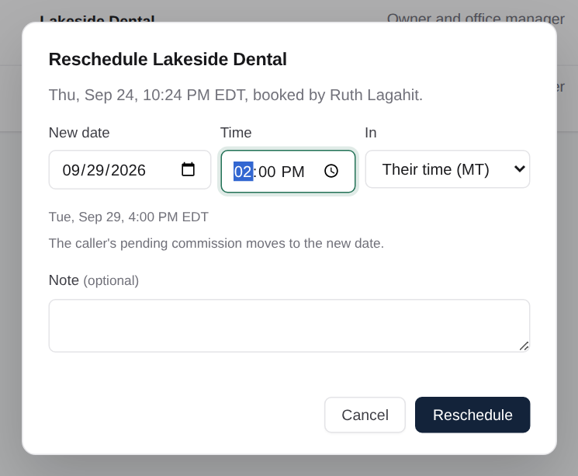
Rescheduled
4
The call moved to a new date.
Enter the new date and time; the Eastern time is shown.
The waiting commissions move to the new call.
It shows in Upcoming until the new time passes.
Notes:
Rescheduled. The call moved to a new date. Enter the new date and time; the Eastern time is shown. The waiting commissions move to the new call. It shows in Upcoming until the new time passes.

Slide 7
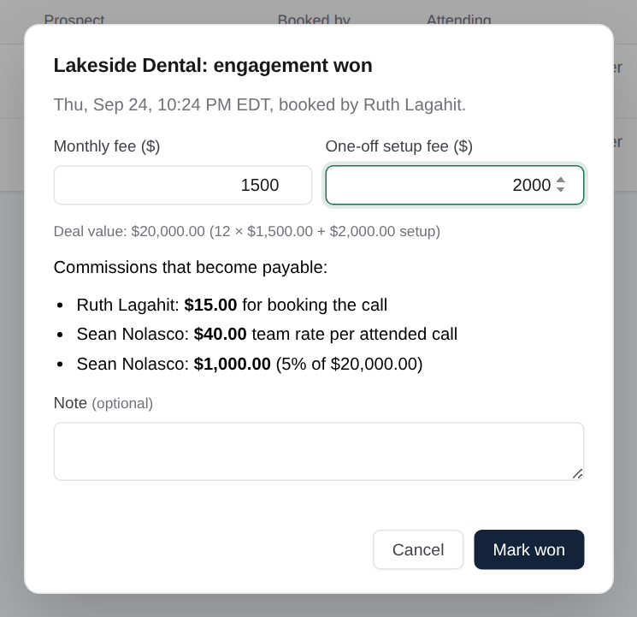
Won
5
The prospect signed.
Enter the monthly fee and the setup fee.
Deal value = 12 months of the monthly fee + the setup fee (changeable in Settings).
Percentage and deal-won commissions are worked out and shown before you confirm.
Notes:
Won. The prospect signed. Enter the monthly fee and the setup fee. Deal value = 12 months of the monthly fee + the setup fee (changeable in Settings). Percentage and deal-won commissions are worked out and shown before you confirm.

Slide 8
What each result does
Pick the result that matches what really happened. Corrections need a written reason.
Attended
No-show
Rescheduled
Commissions become payable. The prospect waits for a decision.
Commissions cancelled. The lead goes back to the caller.
New date. Waiting commissions move with it.
Proposal sent
Won
Lost
A proposal is out. It moves to "Awaiting a decision".
Deal value recorded. Won commissions created and payable.
Closed as lost. Attended commissions stay earned.
Notes:
A result can be corrected later with a reason of at least 10 characters. A paid commission blocks correction until the payment is reversed in Commissions.

Slide 9
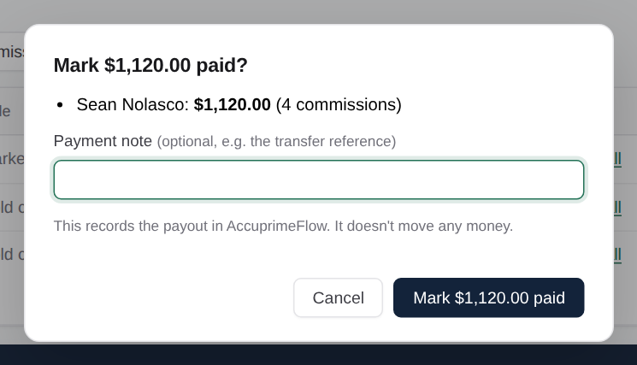
Pay commissions
6
Pay a selection as one payout.
Payable, Waiting and Paid tabs, with totals per person.
"Select all" for a person, then "Mark paid". Add the transfer reference as a note.
This records the payment; it doesn’t move money.
A payment made by mistake can be reversed, with a reason.
Notes:
Pay commissions. Pay a selection as one payout. Payable, Waiting and Paid tabs, with totals per person. "Select all" for a person, then "Mark paid". Add the transfer reference as a note. This records the payment; it doesn’t move money. A payment made by mistake can be reversed, with a reason.

Slide 10
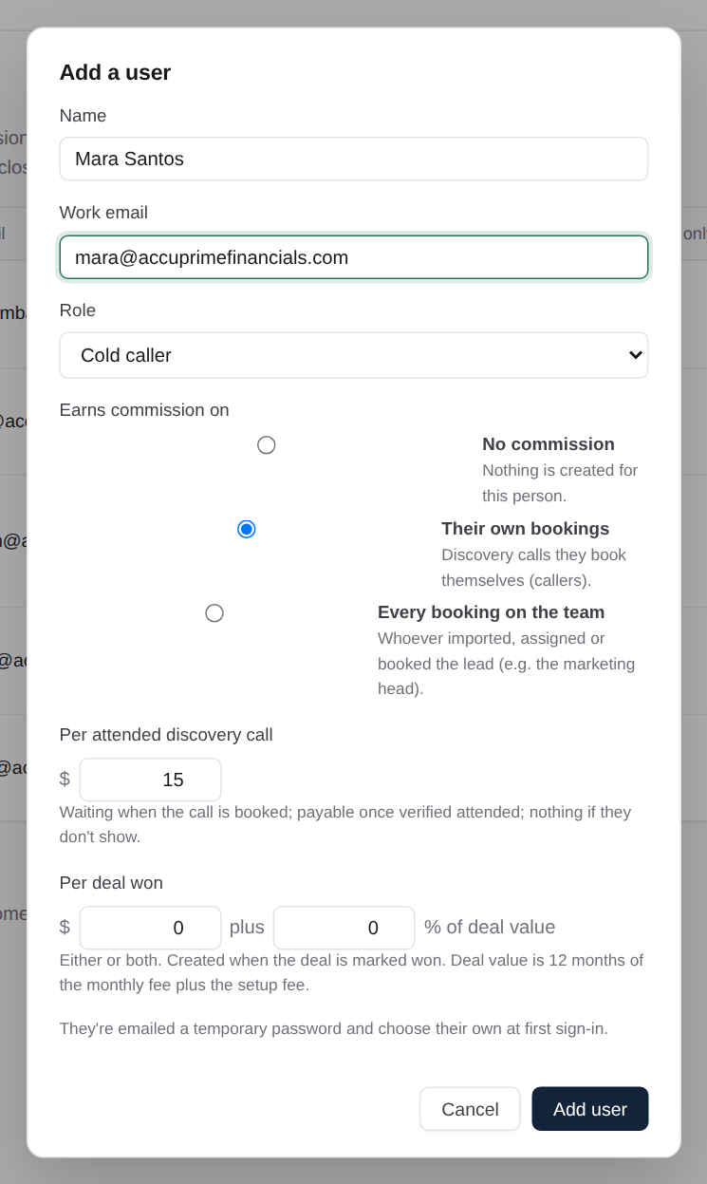
Add people
7
Add each team member and set their commission.
Name, work email and role. They’re emailed a temporary password.
Commission: none, their own bookings, or every booking on the team.
$ per attended call, and $ and/or % per deal won.
Reset password, deactivate, or delete someone with no history.
Notes:
Add people. Add each team member and set their commission. Name, work email and role. They’re emailed a temporary password. Commission: none, their own bookings, or every booking on the team. $ per attended call, and $ and/or % per deal won. Reset password, deactivate, or delete someone with no history.

Slide 11
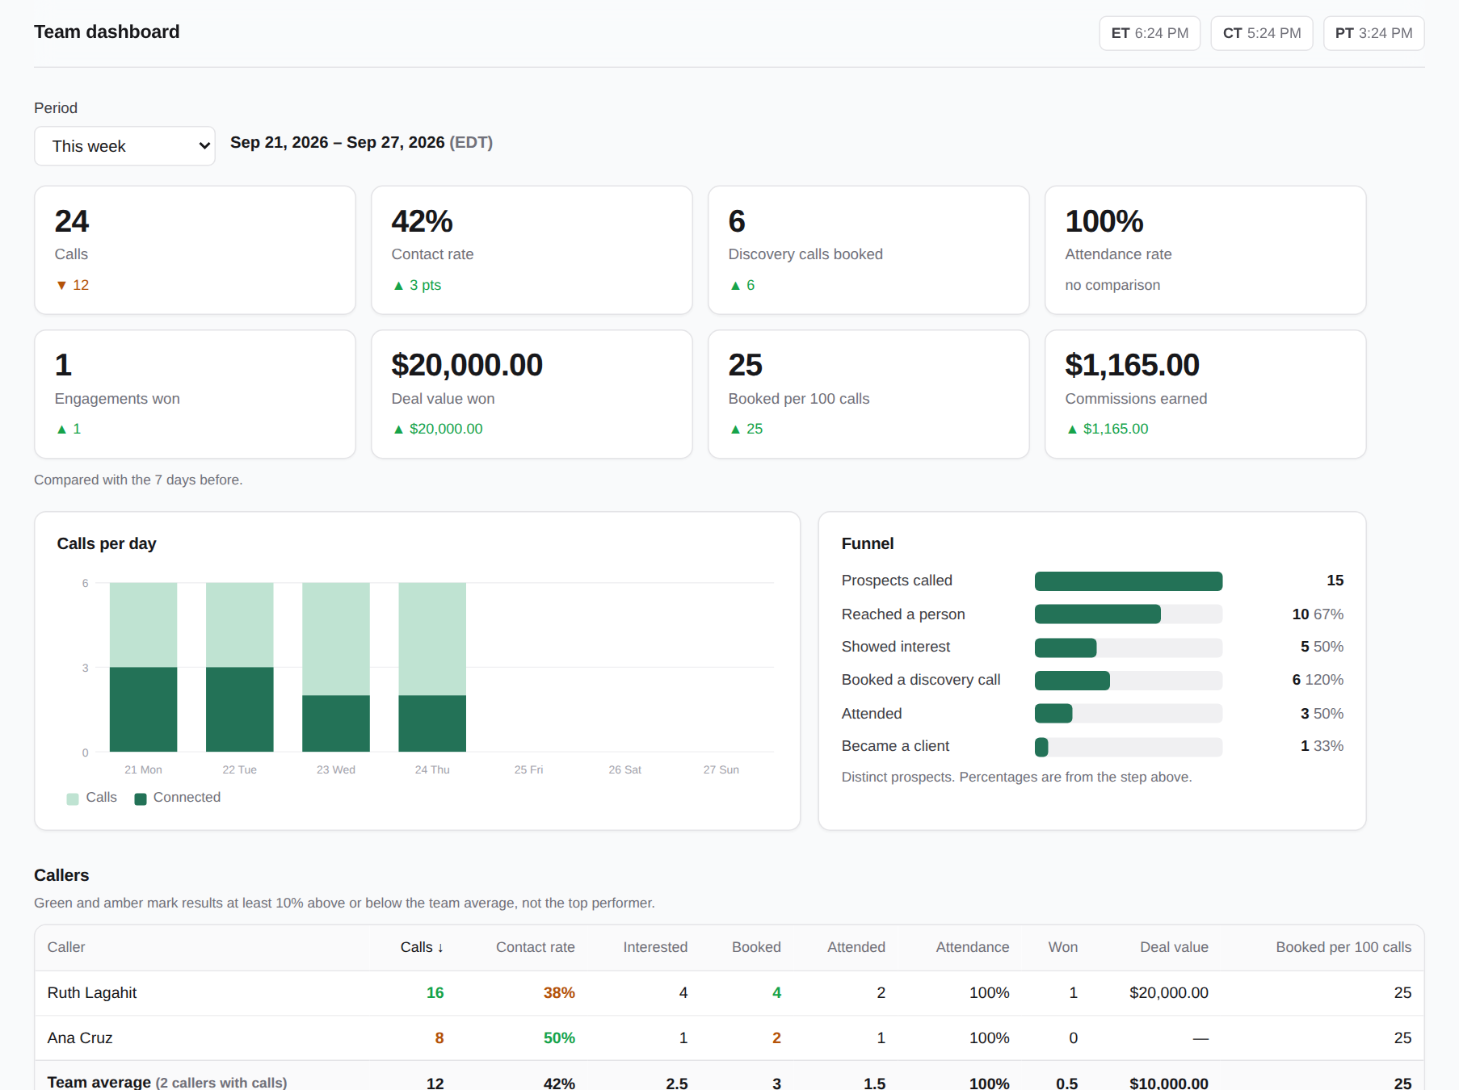
Dashboard and reports
8
See how the team is doing, and export it.
Team dashboard: calls, contact rate, bookings, attendance, won and commissions, against the period before.
Six reports, each exported to Excel, PDF or CSV.
Daily, weekly and monthly summaries arrive by email.
Notes:
Dashboard and reports. See how the team is doing, and export it. Team dashboard: calls, contact rate, bookings, attendance, won and commissions, against the period before. Six reports, each exported to Excel, PDF or CSV. Daily, weekly and monthly summaries arrive by email.

Slide 12
Admin routine
Every day
Every week
Every month
Clear "To verify" before the end of the day. Check the 9 PM reminder if anything is left.
Read the weekly summary. Pay payable commissions, adding the transfer reference.
Read the monthly summary. Run the commission ledger for finance.
New starter
Leaver
Something wrong
Add them in Users with the right role and commission.
Deactivate them. Their open leads return to the pool.
Settings shows email status and the build. Correct results with a reason.
Notes:
A simple routine keeps commissions accurate and callers paid on time.

Slide 13
Questions?
Super admin RB Gumban, rbgumban@accuprimefinancials.com
Settings business rules, email schedule and system status.
Help page www.accuprimeflow.com/help.html
© 2026 Accuprime Financials LLC, Chicago
Notes:
Only the super admin can change settings or delete leads and users.

