Slide 1


AccuprimeFlow for cold callers
How to work your leads, log every call and book discovery calls.
For: Cold callers
www.accuprimeflow.com
Notes:
AccuprimeFlow for cold callers. How to work your leads, log every call and book discovery calls.

Slide 2

How a lead moves through AccuprimeFlow
Your part is the middle of the journey: calling, and booking the discovery call.
1
2
3
4
5
6
Import
Assign
Call
Book
Verify
Pay
Marketing uploads a lead list. Duplicates are caught first.
Leads go to a caller, or are split across the team.
Callers work the queue and log every call with a note.
The caller books a discovery call in the prospect’s time zone.
An admin records what happened after the call. Only admins verify.
Attended calls make commissions payable. Admins pay them.
Only admins verify discovery calls. Callers and marketing never mark a call attended; commissions become payable only after an admin does.
Notes:
Every lead follows the same six steps. Marketing brings the leads in and assigns them. You call them and book discovery calls. After the call has happened, an admin verifies it, and only then does your commission become payable. You never verify your own calls.

Slide 3
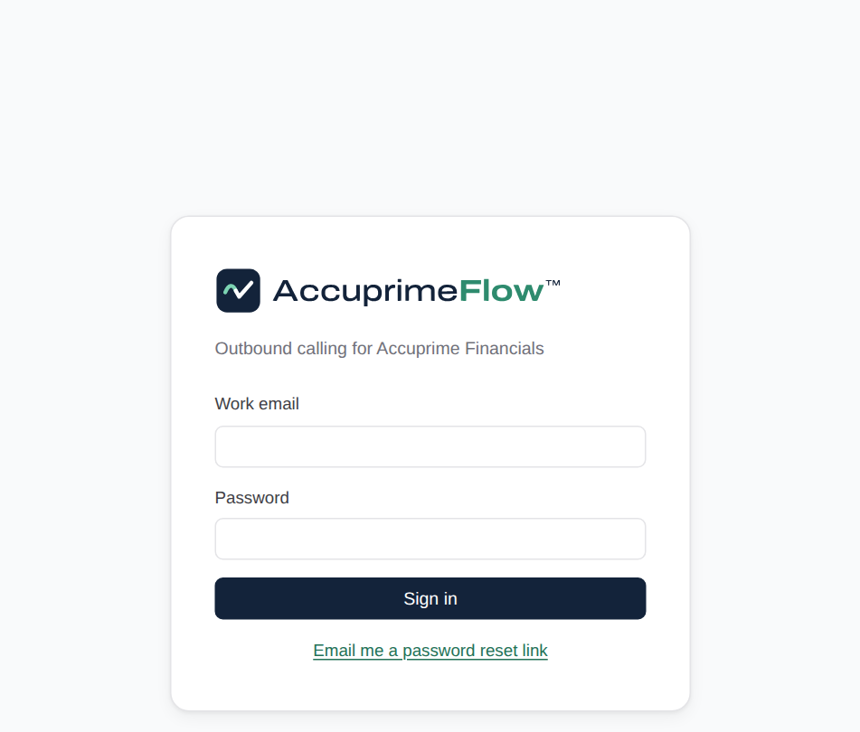
Sign in
1
Go to www.accuprimeflow.com and click Sign in.
Use your Accuprime work email.
First time? Use the temporary password from your welcome email, then choose your own (at least 10 characters).
Forgot it? Click "Email me a password reset link", or ask your admin.
Notes:
Sign in. Go to www.accuprimeflow.com and click Sign in. Use your Accuprime work email. First time? Use the temporary password from your welcome email, then choose your own (at least 10 characters). Forgot it? Click "Email me a password reset link", or ask your admin.

Slide 4
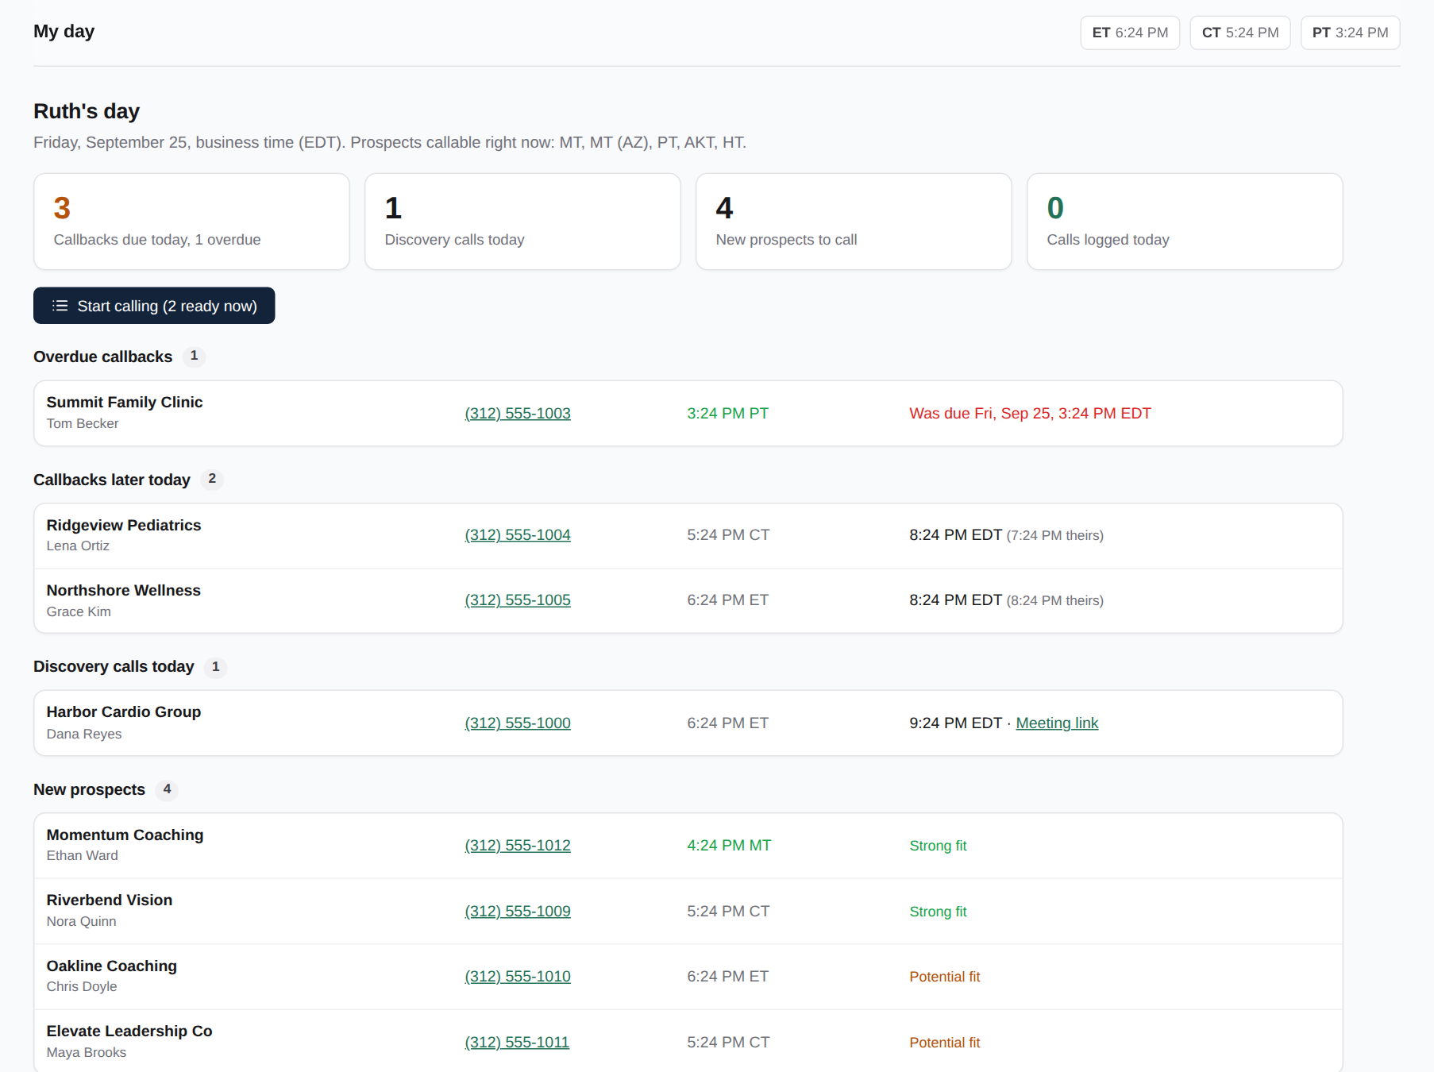
My day
2
Start here every shift. It tells you what to do first.
Overdue callbacks at the top: call these first.
Callbacks due later today, and today’s discovery calls with the meeting link.
New leads you can call right now, in their own time zone.
"Start calling" walks you through them one by one.
Notes:
My day. Start here every shift. It tells you what to do first. Overdue callbacks at the top: call these first. Callbacks due later today, and today’s discovery calls with the meeting link. New leads you can call right now, in their own time zone. "Start calling" walks you through them one by one.

Slide 5
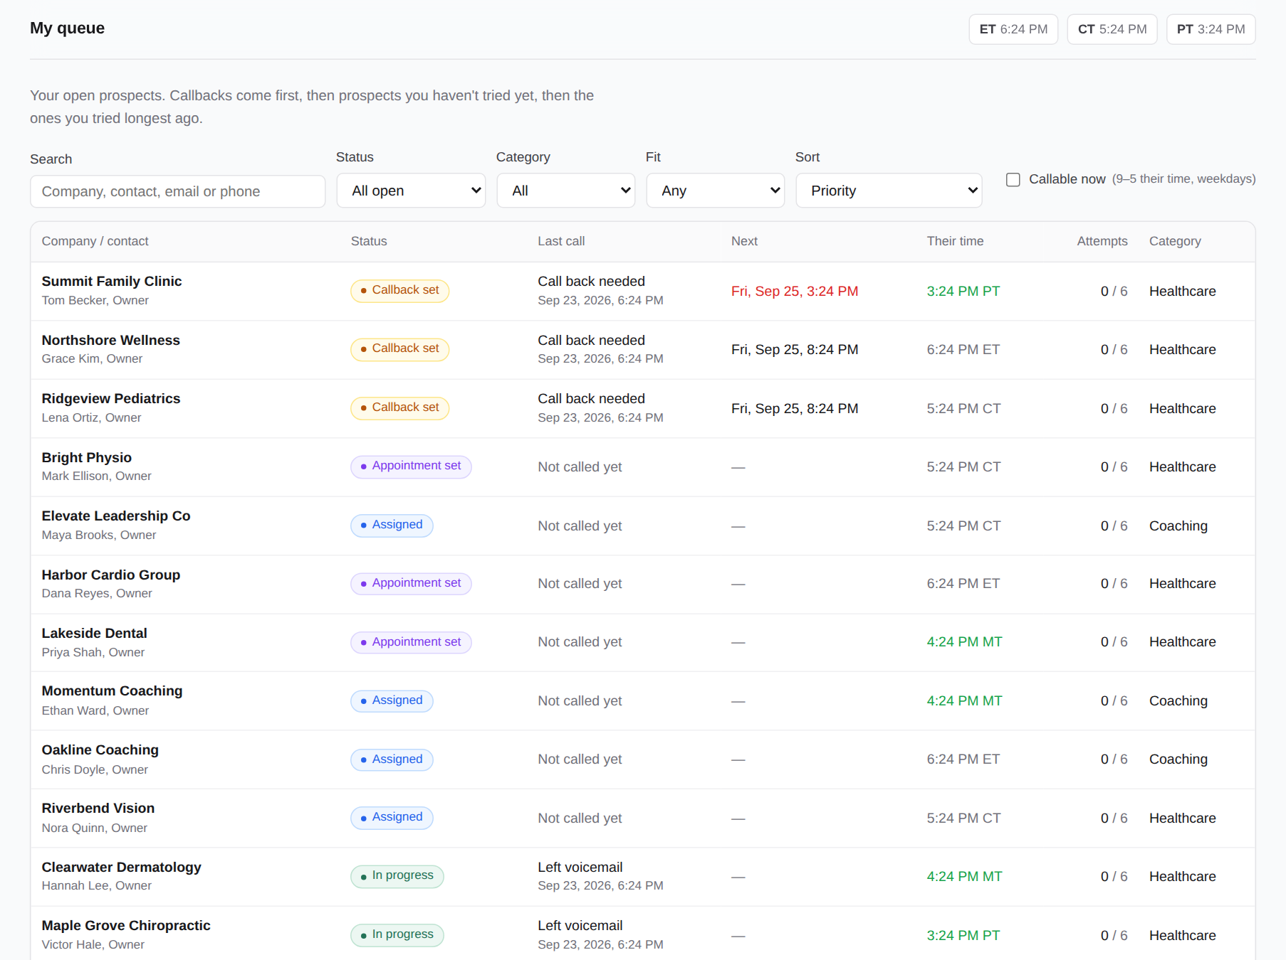
My queue
3
All your open leads, already in the right order.
Callbacks first by time, then leads never called, then the longest since last try.
Filter by category, time zone, or "callable now".
Attempts show how close a lead is to closing as unreachable.
Notes:
My queue. All your open leads, already in the right order. Callbacks first by time, then leads never called, then the longest since last try. Filter by category, time zone, or "callable now". Attempts show how close a lead is to closing as unreachable.

Slide 6
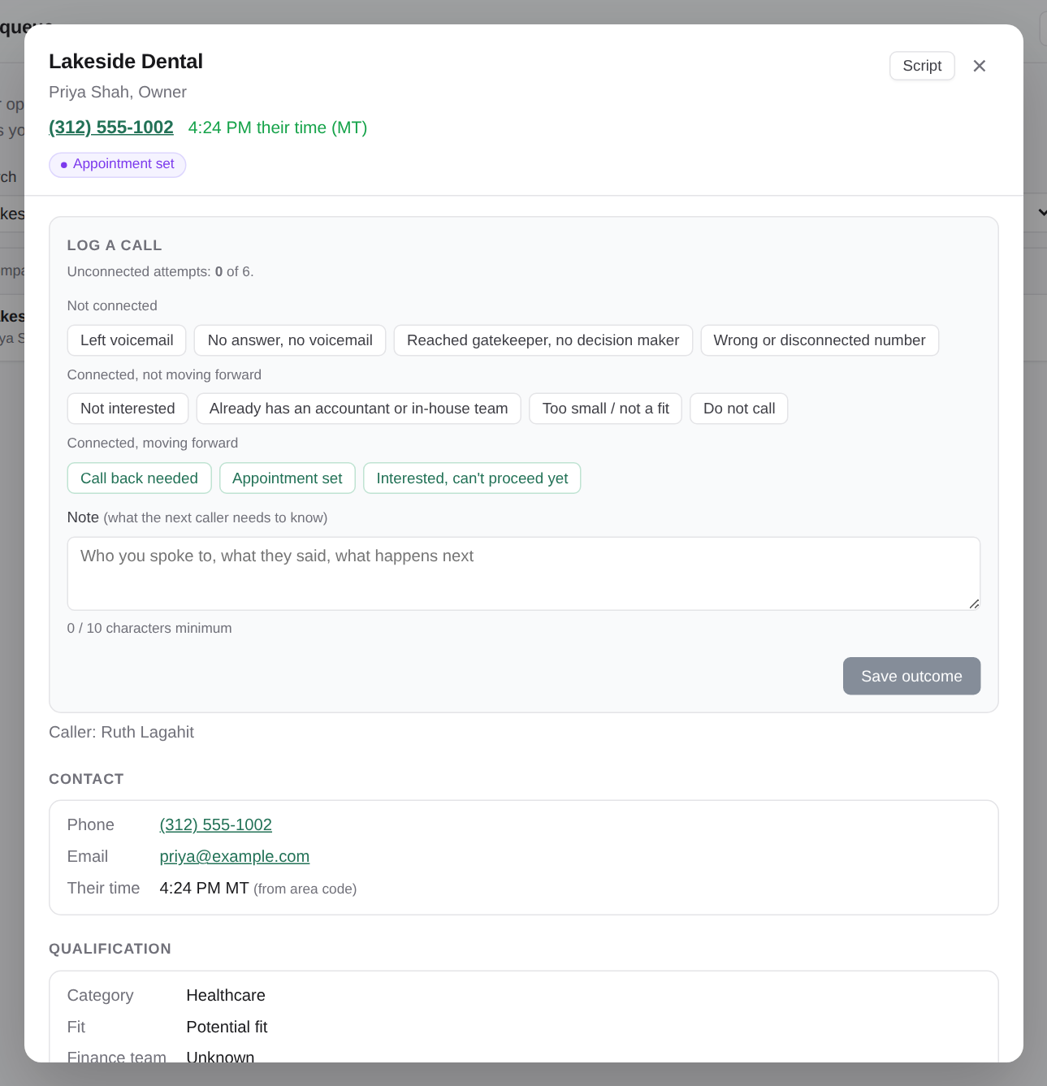
Open a prospect
4
Click a company to open it in the middle of the screen.
Their local time is shown next to the phone number.
Contact details, qualification notes and every earlier call are here.
Open "Script" to see your call script beside the prospect.
Notes:
Open a prospect. Click a company to open it in the middle of the screen. Their local time is shown next to the phone number. Contact details, qualification notes and every earlier call are here. Open "Script" to see your call script beside the prospect.

Slide 7
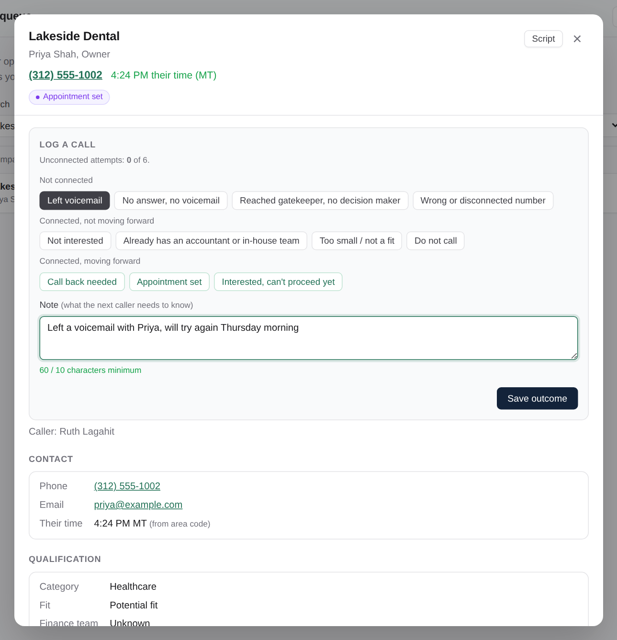
Log every call
5
Pick what happened, write a note, save.
Not connected: voicemail, no answer, gatekeeper, wrong number.
Connected: not interested, has an accountant, not a fit, do not call.
Moving forward: call back, appointment set, interested but not yet.
The note must be at least 10 characters. Write what the next person needs to know.
Notes:
Log every call. Pick what happened, write a note, save. Not connected: voicemail, no answer, gatekeeper, wrong number. Connected: not interested, has an accountant, not a fit, do not call. Moving forward: call back, appointment set, interested but not yet. The note must be at least 10 characters. Write what the next person needs to know.

Slide 8
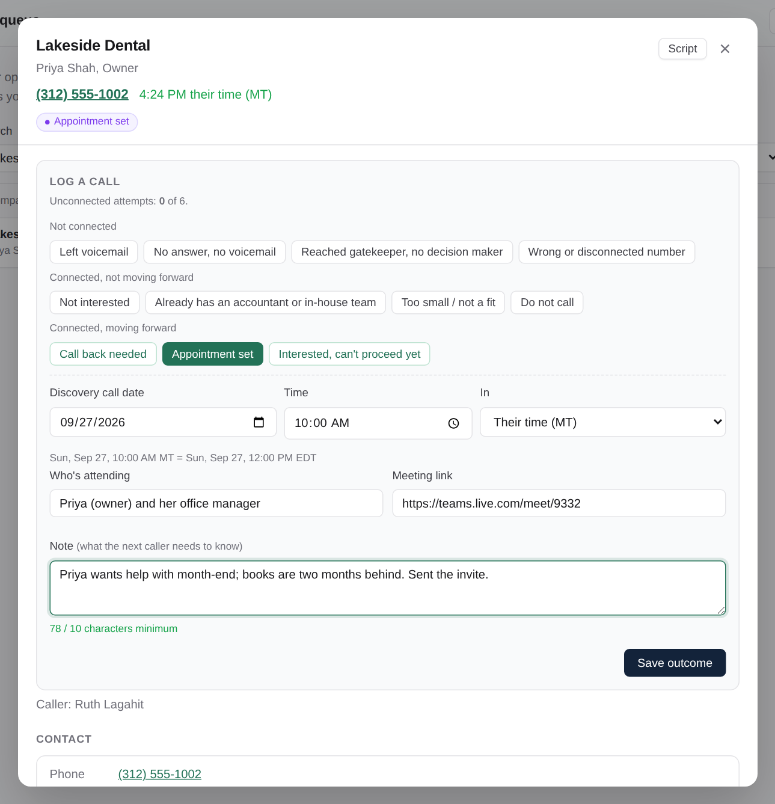
Book a discovery call
6
Choose "Appointment set" and fill in the details.
Enter the date and time in the prospect’s own time zone; AccuprimeFlow shows it in Eastern too.
Add who is attending and the meeting link.
Save: admins and you get an email straight away.
Send the prospect their confirmation yourself, as the team does today.
Notes:
Book a discovery call. Choose "Appointment set" and fill in the details. Enter the date and time in the prospect’s own time zone; AccuprimeFlow shows it in Eastern too. Add who is attending and the meeting link. Save: admins and you get an email straight away. Send the prospect their confirmation yourself, as the team does today.

Slide 9
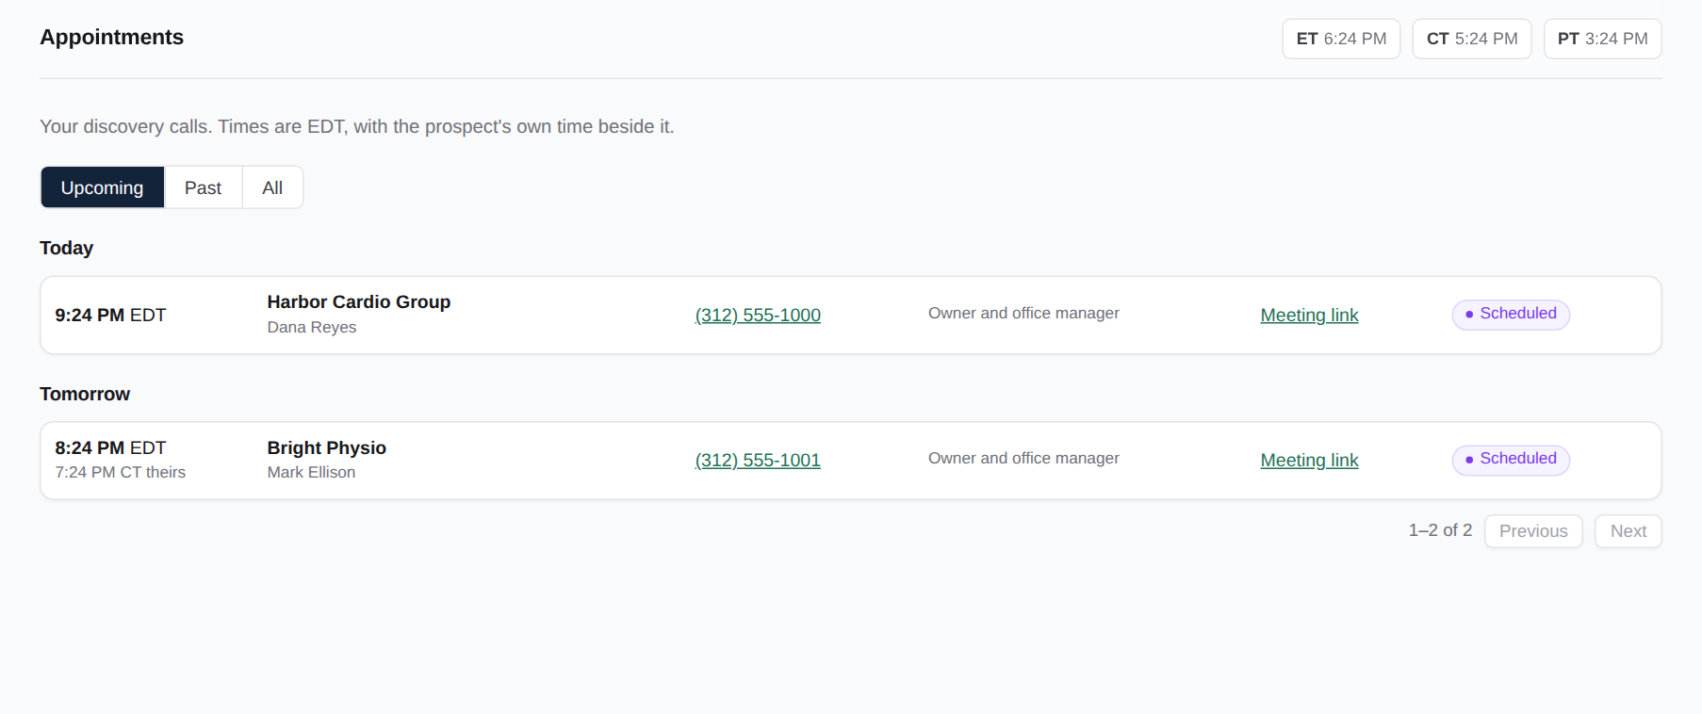
Your appointments
7
Every discovery call you booked, grouped by day.
Upcoming, Past or All.
Eastern time with the prospect’s time beside it, the meeting link and the result.
"To verify" means the time has passed and an admin still needs to record what happened.
Notes:
Your appointments. Every discovery call you booked, grouped by day. Upcoming, Past or All. Eastern time with the prospect’s time beside it, the meeting link and the result. "To verify" means the time has passed and an admin still needs to record what happened.

Slide 10
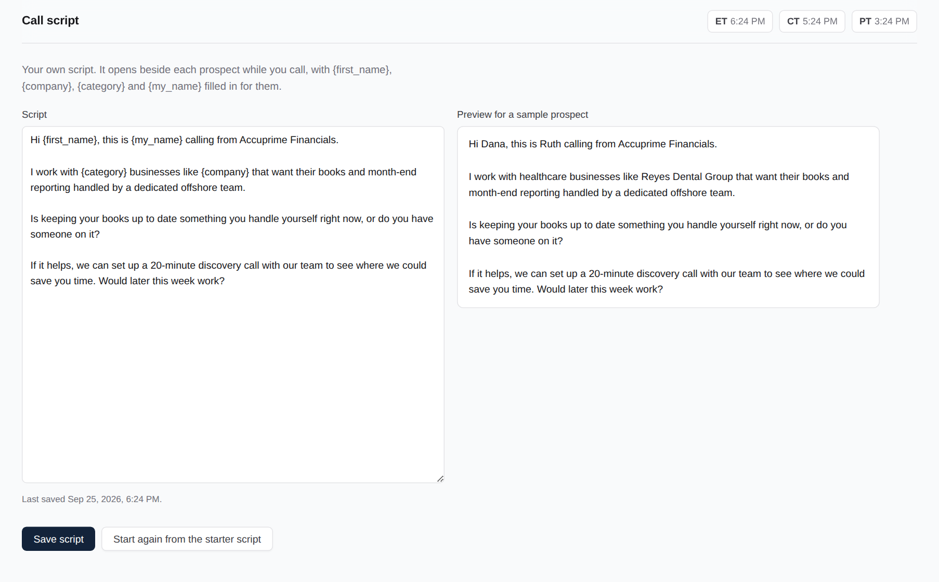
Call script
8
Write your script once; it fills itself in.
Use {first_name}, {company}, {category} and {my_name}.
The preview shows exactly what you’ll say to a real prospect.
Open it from any prospect with the Script button.
Notes:
Call script. Write your script once; it fills itself in. Use {first_name}, {company}, {category} and {my_name}. The preview shows exactly what you’ll say to a real prospect. Open it from any prospect with the Script button.

Slide 11
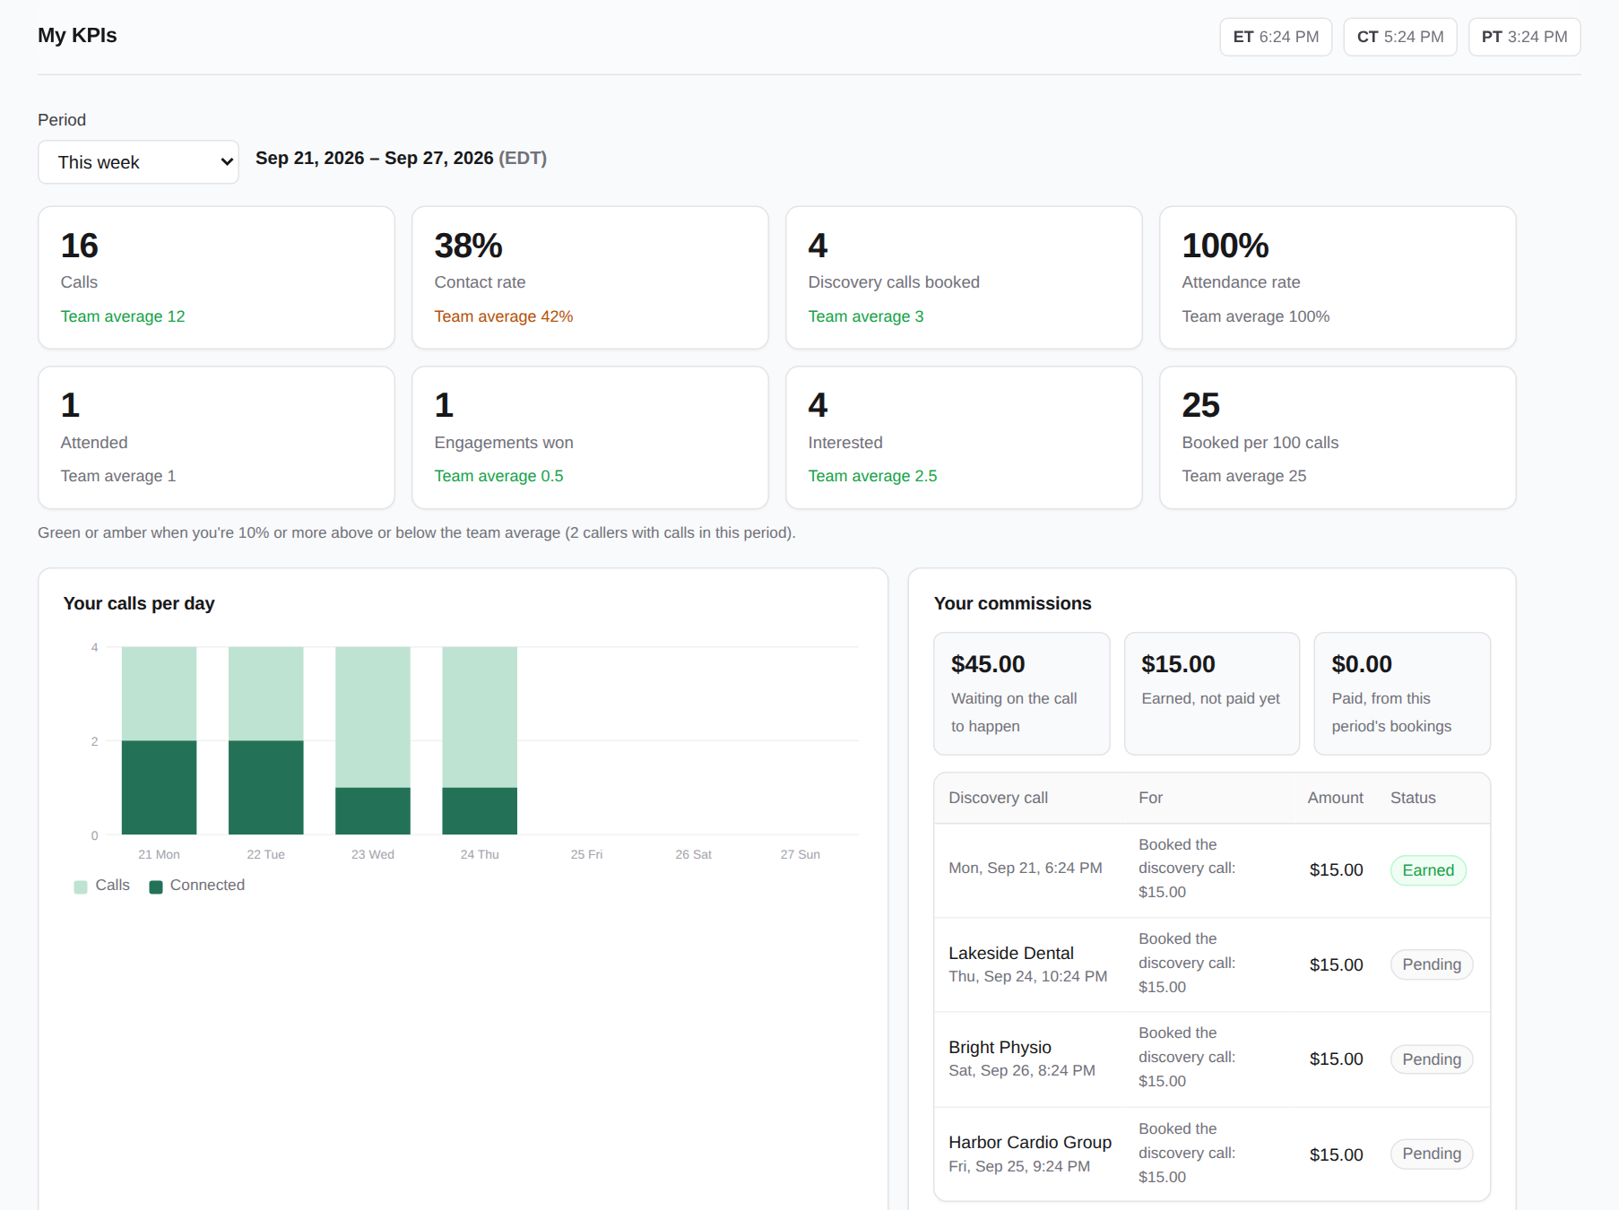
My KPIs
9
How you’re doing, against the team average.
Calls, contact rate, discovery calls booked and attendance.
Green means 10% or more above the team average; amber means below.
Pick today, this week, this month or your own dates.
Notes:
My KPIs. How you’re doing, against the team average. Calls, contact rate, discovery calls booked and attendance. Green means 10% or more above the team average; amber means below. Pick today, this week, this month or your own dates.

Slide 12
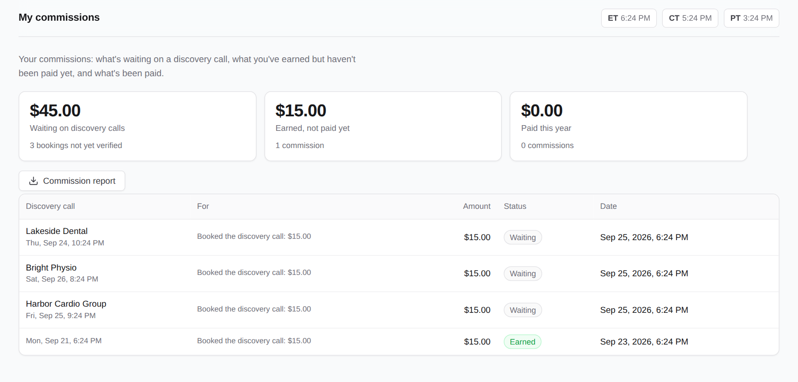
My commissions
10
You earn when the prospect actually attends.
Waiting: the discovery call is booked but hasn’t been verified yet.
Earned: an admin verified that the prospect attended. It will be paid.
No-show: no commission. The lead comes back to you to follow up.
Only admins verify. You can’t mark your own calls attended.
Notes:
My commissions. You earn when the prospect actually attends. Waiting: the discovery call is booked but hasn’t been verified yet. Earned: an admin verified that the prospect attended. It will be paid. No-show: no commission. The lead comes back to you to follow up. Only admins verify. You can’t mark your own calls attended.

Slide 13
Rules to remember
Eastern time
Six tries
Notes matter
Every date, report and email uses Eastern time. The clocks at the top show ET, CT and PT.
After six unanswered attempts a lead closes as unreachable. Callbacks and real conversations don’t count.
Every call needs a note of at least 10 characters. Write it for the next person who calls.
Do not call
Book in their time
Admins verify
If a prospect asks not to be called, log "Do not call". They’re never called or imported again.
Enter the discovery call in the prospect’s time zone. The screen shows both times before you save.
Only an admin records whether the discovery call happened. That’s what makes your commission payable.
Notes:
Six rules the system enforces. The six-attempt cap and note length are set by the super admin in Settings.

Slide 14
Questions?
Your admin for accounts, passwords and anything that looks wrong.
Help page www.accuprimeflow.com/help.html
Build number in your account menu. Include it when you report a problem.
© 2026 Accuprime Financials LLC, Chicago
Notes:
Point people to their admin first. The build number helps tell a real problem from an old page in the browser.

