Slide 1


AccuprimeFlow for marketing
How to import lead lists, assign them to callers and see which lists work.
For: Marketing
www.accuprimeflow.com
Notes:
AccuprimeFlow for marketing. How to import lead lists, assign them to callers and see which lists work.

Slide 2

How a lead moves through AccuprimeFlow
Your part is the start of the journey, and knowing which lists turn into clients.
1
2
3
4
5
6
Import
Assign
Call
Book
Verify
Pay
Marketing uploads a lead list. Duplicates are caught first.
Leads go to a caller, or are split across the team.
Callers work the queue and log every call with a note.
The caller books a discovery call in the prospect’s time zone.
An admin records what happened after the call. Only admins verify.
Attended calls make commissions payable. Admins pay them.
Only admins verify discovery calls. Callers and marketing never mark a call attended; commissions become payable only after an admin does.
Notes:
Marketing owns the first two steps: bringing leads in cleanly and getting them to the right callers. Callers call and book. Admins verify discovery calls; marketing doesn’t verify.

Slide 3
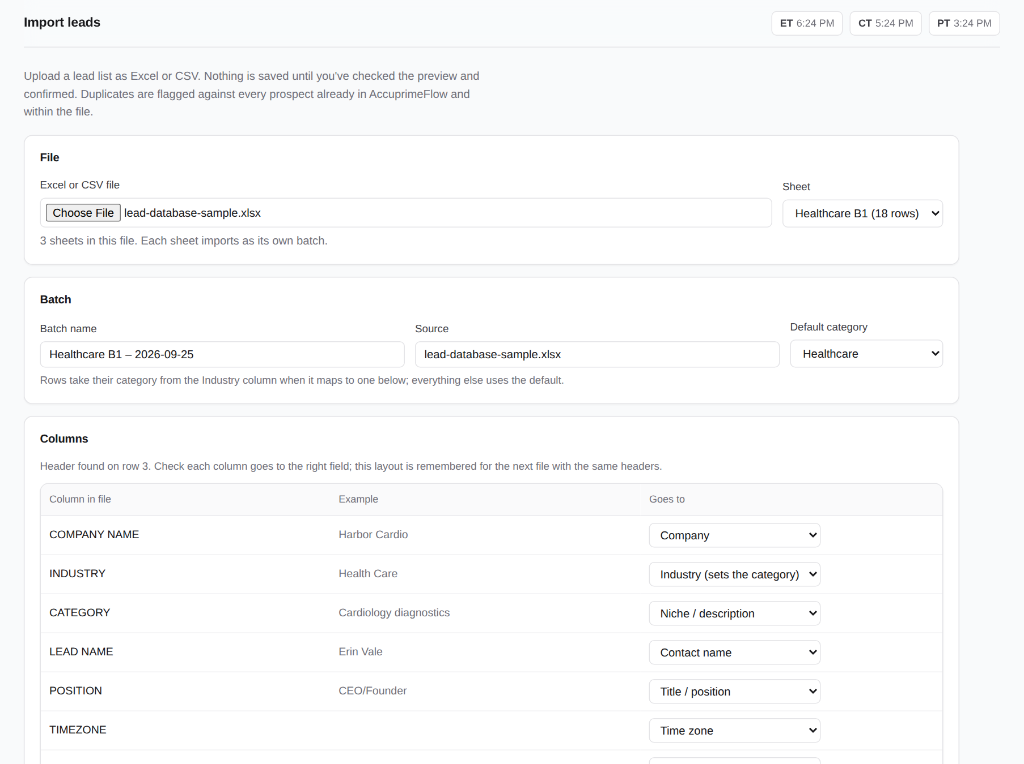
Import a lead list
1
Choose an Excel or CSV file, then check the columns.
AccuprimeFlow finds the header row and matches most columns for you.
Pick the sheet, name the batch, set the source (for example Apollo).
Choose the default category; industry spellings are remembered for next time.
Notes:
Import a lead list. Choose an Excel or CSV file, then check the columns. AccuprimeFlow finds the header row and matches most columns for you. Pick the sheet, name the batch, set the source (for example Apollo). Choose the default category; industry spellings are remembered for next time.

Slide 4
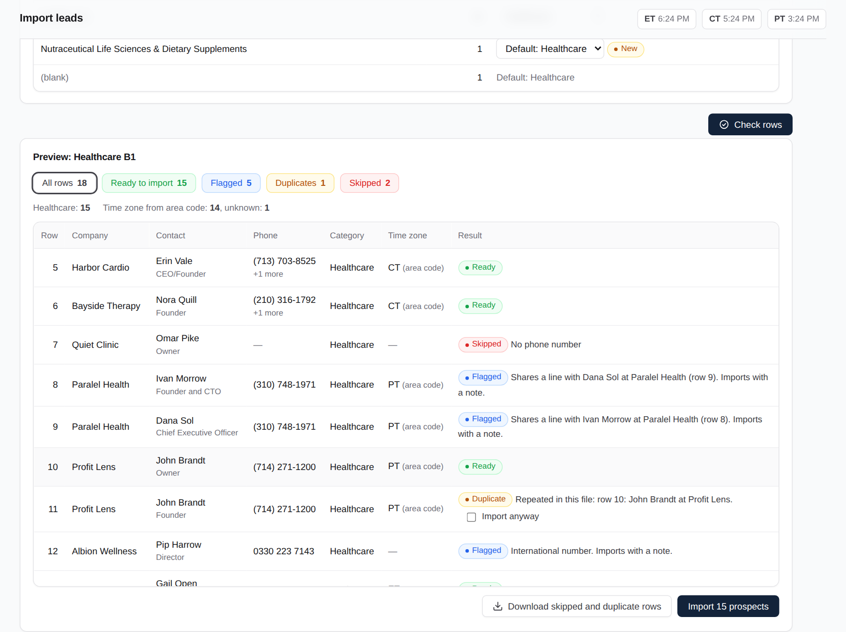
Check the preview
2
Click "Check file" and read the counts before importing.
Ready: will be imported.
Flagged: will be imported, with a note (shared phone line, international number).
Duplicates and skipped rows are not imported. Download the list to see why.
Notes:
Check the preview. Click "Check file" and read the counts before importing. Ready: will be imported. Flagged: will be imported, with a note (shared phone line, international number). Duplicates and skipped rows are not imported. Download the list to see why.

Slide 5
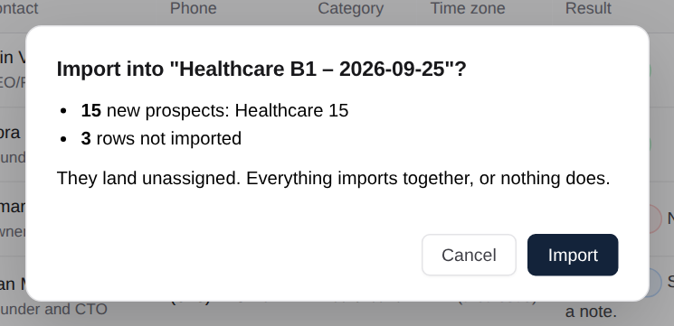
Import
3
Confirm, and the list goes in as one batch.
The confirmation shows the totals by category.
Large files import in parts automatically, with progress shown.
The batch appears under Recent imports.
Notes:
Import. Confirm, and the list goes in as one batch. The confirmation shows the totals by category. Large files import in parts automatically, with progress shown. The batch appears under Recent imports.

Slide 6
How duplicates are handled
AccuprimeFlow checks every row against the file itself and everything already in the system.
Same person, same phone
Two people, one phone
Closed before
A duplicate. Skipped, unless you tick "Import anyway" after checking it.
A shared line, such as a clinic’s front desk. Both come in, flagged.
Skipped, or reopened on purpose if you tick "Reopen", keeping its history.
Do not call
No phone or no company
Test upload by mistake
Always skipped. There’s no way to import it again.
Skipped, with the reason shown in the preview.
The super admin can delete a whole import from Recent imports.
Notes:
These rules protect the callers from calling the same person twice and keep do-not-call requests respected.

Slide 7
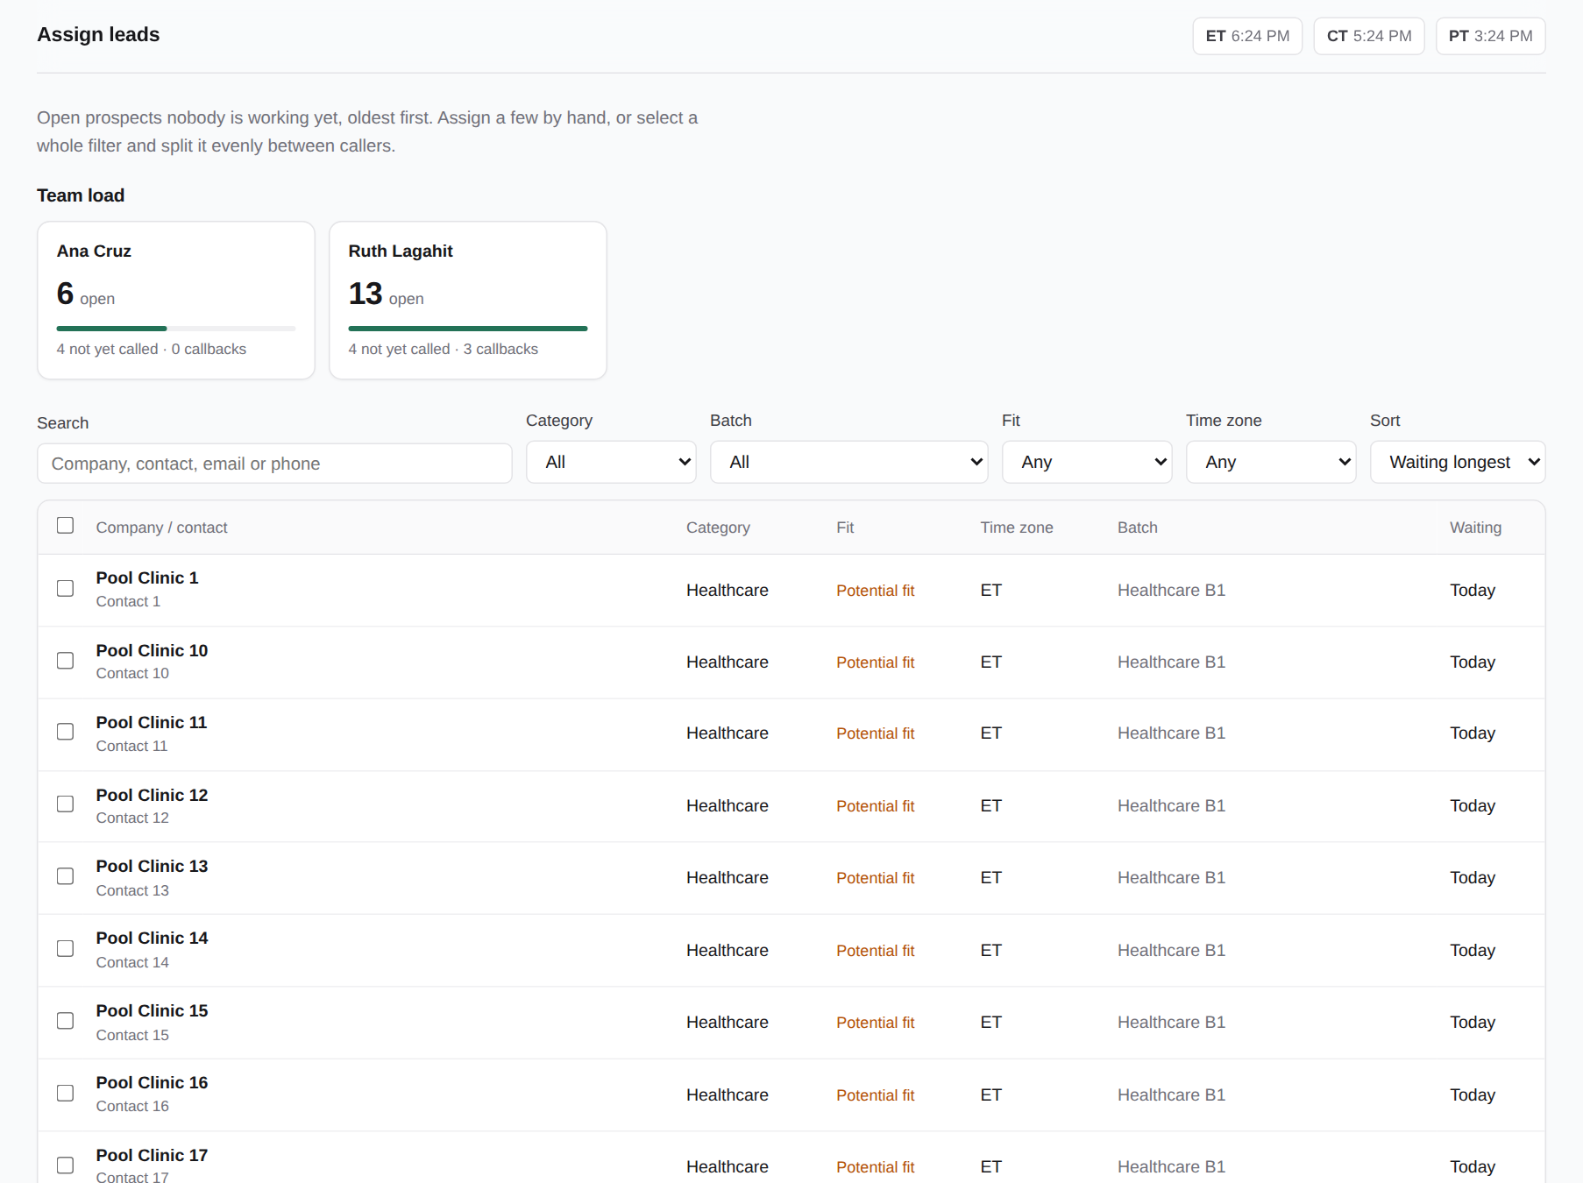
Assign leads
4
New leads wait in the pool until you hand them out.
Team load shows each caller’s open leads, callbacks and discovery calls.
Filter by batch, category, fit or time zone.
Leads waiting a day or more are highlighted.
Notes:
Assign leads. New leads wait in the pool until you hand them out. Team load shows each caller’s open leads, callbacks and discovery calls. Filter by batch, category, fit or time zone. Leads waiting a day or more are highlighted.

Slide 8
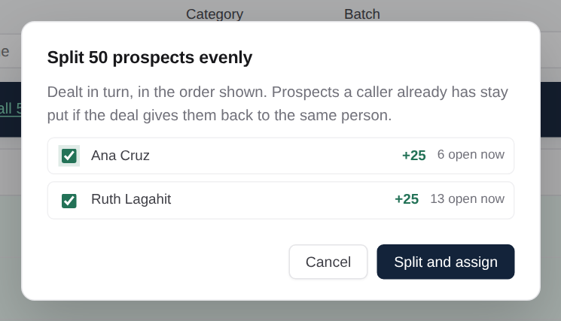
Assign or split
5
Select leads, then give them to one caller or split them evenly.
Tick a page, or "Select all matching" for thousands at once.
"Split evenly" deals them across the callers you choose.
Reassigning keeps each lead’s full call history.
Notes:
Assign or split. Select leads, then give them to one caller or split them evenly. Tick a page, or "Select all matching" for thousands at once. "Split evenly" deals them across the callers you choose. Reassigning keeps each lead’s full call history.

Slide 9
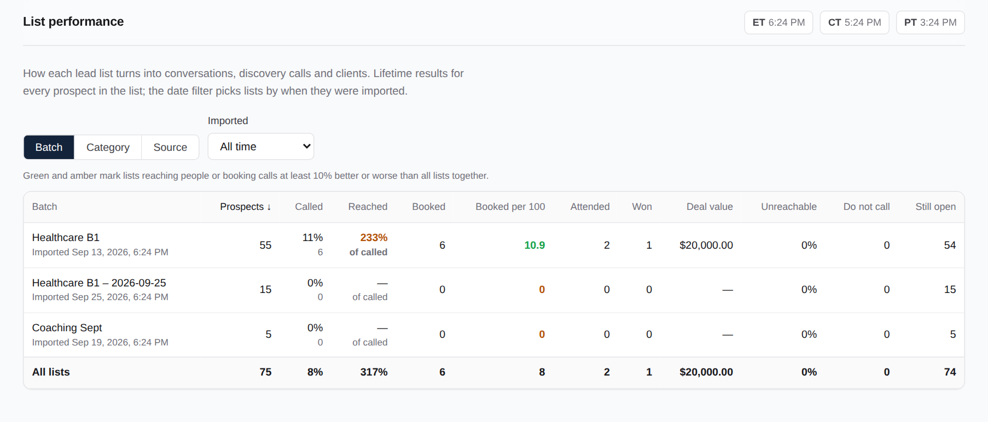
List performance
6
Which lists, sources and categories turn into clients.
By batch, category or source.
Called, reached, booked, attended and won for each list.
Green and amber mark lists doing better or worse than average.
Notes:
List performance. Which lists, sources and categories turn into clients. By batch, category or source. Called, reached, booked, attended and won for each list. Green and amber mark lists doing better or worse than average.

Slide 10
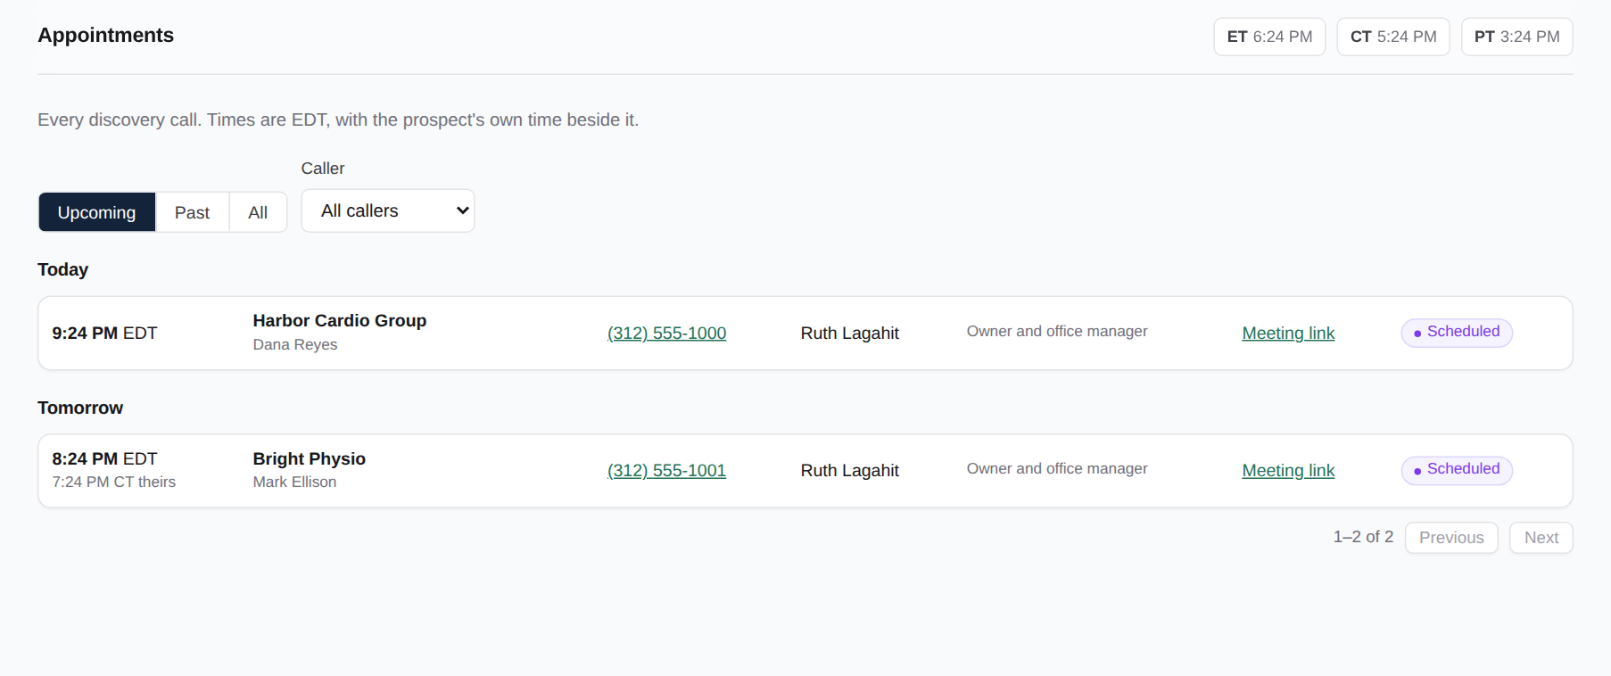
Appointments
7
Every discovery call the team has booked.
Upcoming or past, grouped by day, with the caller and the result.
Filter by caller.
Recording what happened is done by an admin in Verification.
Notes:
Appointments. Every discovery call the team has booked. Upcoming or past, grouped by day, with the caller and the result. Filter by caller. Recording what happened is done by an admin in Verification.

Slide 11
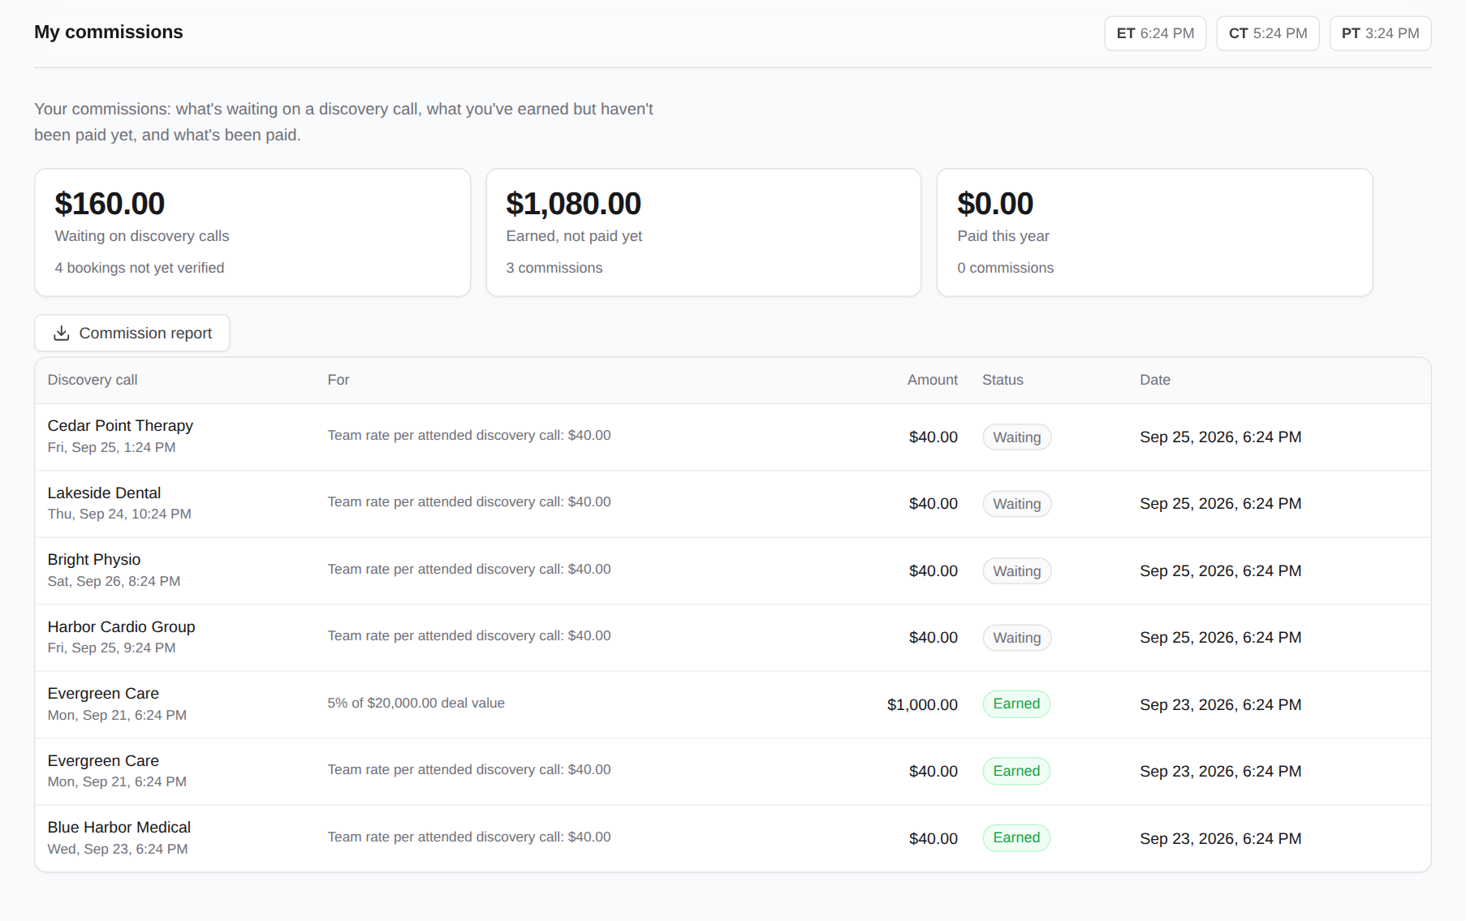
My commissions
8
If you earn a team commission, it shows here.
Waiting: a discovery call is booked but not yet verified.
Earned: an admin verified that the prospect attended, or the deal was won.
No-show: nothing is earned for that call.
Your commission is set by an admin when your account is created.
Notes:
My commissions. If you earn a team commission, it shows here. Waiting: a discovery call is booked but not yet verified. Earned: an admin verified that the prospect attended, or the deal was won. No-show: nothing is earned for that call. Your commission is set by an admin when your account is created.

Slide 12
Questions?
Your admin for accounts, commission settings and anything that looks wrong.
Help page www.accuprimeflow.com/help.html
Build number in your account menu. Include it when you report a problem.
© 2026 Accuprime Financials LLC, Chicago
Notes:
Marketing can import, assign and report. Only admins verify discovery calls and pay commissions.

